Slide 1

Evaluating the Performance of Object Detection Models for Accurate Sri Lankan Traffic Sign Detection
Learner Name: MN. Sihanas
Student Id: 1030371
Course & Batch: HND in Computing - 22
Assessor: Mrs. ALF. Sajeetha
Supervisor: Mrs. NF. Mafaza
Notes:
I am MN. Sihanas, and today I will be presenting my completed research project titled ‘Evaluating the Performance of Object Detection Models for Accurate Sri Lankan Traffic Sign Detection’.
This research was conducted as part of my Higher National Diploma in Computing, under the guidance of my supervisor, Mrs. NF. Mafaza. And Mrs. ALF. Sajeetha.”

Slide 2
Table of Contents
Introduction.
Research background.
Problem statement.
Research question & Hypothesis.
Methodology.
Top level architecture.
Literature Review.
Dataset brief.
Model Evaluation.
Main Findings
Limitations.
Future Work.
Conclusion.
Acknowledgement.
Table of Contents
Notes:
Here are the main topics that I will cover in this presentation

Slide 3

Introduction.
Notes:
Let me give you a small introduction about this study.

Slide 4

Introduction
Importance of traffic sign detection in AI and computer vision.
Relevance to Sri Lankan road systems.
Comparing YOLOv8, Faster R-CNN, and SSD using mAP and F1-Score.
Notes:
“This study focuses on the importance of traffic sign detection in AI and computer vision applications, particularly for Sri Lanka’s road systems.
I compared three well-known object detection models — YOLOv8, Faster R-CNN, and SSD — using mAP and F1-score metrics, with the aim of identifying the best performer for Sri Lankan traffic sign detection.”

Slide 5
Research Background.
Notes:
Let see the background of this research.

Slide 6

Rising significance of autonomous vehicles and driver assistance systems
Reliable traffic sign detection is a key requirement for road safety and autonomous driving
The performance of object detection models varies under different conditions, especially in real-world scenarios
Few comparative studies exist focusing on their performance with Sri Lankan road signs
This study aims to fill that gap by evaluating YOLOv8, Faster R-CNN, and SSD for their accuracy in detecting Sri Lankan traffic signs
Notes:
“Globally, autonomous vehicles and driver assistance systems are gaining importance, and reliable traffic sign detection is a key requirement for both road safety and autonomy.
However, the performance of object detection models can vary under different conditions, especially in real-world scenarios.
Very few comparative studies have evaluated these models specifically on Sri Lankan traffic signs.
This study addresses that gap by evaluating selected model in our local context.”

Slide 7
Problem Statement.
Notes:
Now let’s focus on the problem statement.

Slide 8
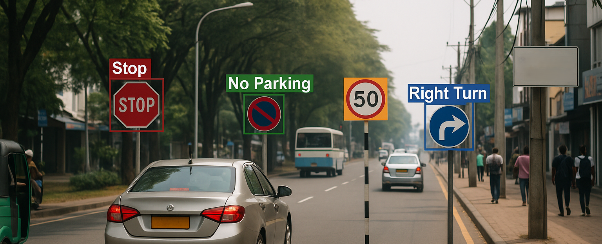
Traffic sign detection is crucial for autonomous vehicles and road safety.
Currently, object detection models show varying performance under different conditions.
There’s a lack of comparative studies evaluating their accuracy on Sri Lankan road signs.
This inconsistency poses a challenge for developing reliable autonomous vehicle technologies.
This study aims to compare and identify the most accurate and efficient model for Sri Lankan conditions.
Notes:
“There’s a lack of comparative studies evaluating the accuracy of object detection models on Sri Lankan road signs. This inconsistency makes it hard to choose a reliable algorithm for autonomous vehicles. So, this study directly compares the models to identify which performs most accurately in our context.”

Slide 9
Research
Question & Hypothesis

Slide 10
Research Question
Research Question: Which object detection model (YOLOv8, Faster R-CNN, or SSD) achieves the highest accuracy in detecting Sri Lankan traffic signs, as measured by mean Average Precision (mAP) and F1-Score?
Alternative Hypothesis: Among the three models YOLOv8 would achieve the highest combined performance based on mAP and F1-Score.
Dependent Variables: Mean Average Precision (mAP) (the accuracy of the models), F1-Score.
Independent Variable: The object detection model used (YOLOv8, Faster R-CNN, SSD).
Notes:
The key research question driving this study is: Which object detection model among the three, achieves the highest accuracy in detecting Sri Lankan traffic signs, as measured by mean Average Precision, and f1 score?
the alternative hypothesis stated that YOLOv8 would achieve the highest combined performance based on mAP and F1-score. My results, which I will present shortly, confirmed the alternative hypothesis.”
In this study meanAveragePrecision and F1-Score will be the dependant variables and independent variable are going to be the selected models.

Slide 11
Methodology

Slide 12
Research Design: Quantitative research.
Data Collection Method: Secondary dataset (Sri Lankan traffic sign dataset).
Evaluation Approach: Analyze the performance of YOLOv8, Faster R-CNN, and SSD. Use mean Average Precision (mAP) and F1-Score as the key evaluation metric.
Comparison & Analysis: Compare the models based on mAP and F1 scores. Identify the most effective model for Sri Lankan traffic sign detection.
Notes:
For this study I used the the quantitative research design, as our focus is on measuring numerical performance values.
The data collection method involves using a secondary dataset. Which was collected from Roboflow which was properly labeled and pre-processed.
To assess these models, I analyzed the performance using mean Average Precision and f1 score, which is a widely used metrics for these kind of task.
Finally, I compared the models based on their mAP scores and analyze the results to identify the most effective model. And developed a system to show the usability.

Slide 13
Top level architecture

Slide 14
Literature Review
Research Planning & Proposal
Preliminary Study
Dataset (Sri Lankan Traffic Sign)
Preprocessing.
(annotating (TXT, VOC))
Model Inference (YOLOv8, Faster R-CNN, SSD)
Best Model Selection
Comparison & Analysis
Evaluation (mAP & F1-Score)
System development
Report & Documentation
Notes:
This diagram summarizes my research workflow.
I began with research planning, preliminary studies, and literature review.
then I gathered the Sri Lankan traffic sign dataset, arranging annotation formats suitable for all three models, followed by training and testing each model.
After evaluation and comparison, I selected the best performer and developed a real-time detection application to demonstrate its practical usability, finally the documentation.”

Slide 15
Literature Review
Notes:
“We reviewed related studies to understand their methods and results. This helps us identify gaps and guides our own approach. I'll briefly go over the main points from these papers.”

Slide 16
Paper: Performance Comparison of Object Detection Models for Road Sign Detection Under Different Conditions (Fatima et al., 2024)
Context & Aim
Compare state-of-the-art detectors (YOLOv8, YOLOv9, RTMDet, Faster R‑CNN, RetinaNet) under varied environmental and operational conditions in road sign detection.
Methodology
Fine-tuned models on large-scale datasets.
Evaluated using metrics: mean Average Precision (mAP), frames-per-second (FPS), and model loss.
Included additional training enhancements: data augmentation and hyperparameter tuning.
Results
YOLOv8 and YOLOv9 achieved highest real-time detection rates.
RTMDet offered the best trade-off between speed and accuracy.
Faster R‑CNN and RetinaNet delivered higher precision but were slower.
Research Gap
Analysis conducted on general (non-region-specific) datasets.
Lacks focused evaluation on the unique characteristics of Sri Lankan traffic signs.
Notes:
“This study compared state-of-the-art detectors under different conditions. It found that YOLOv8 and YOLOv9 performed the best in real time, while RTMDet was a balance of speed and accuracy. However, their evaluation was not done with a region-specific dataset, which is a gap we aim to fill.”

Slide 17
Paper: A Traffic‑Sign Detection Algorithm Based on Improved Sparse R‑CNN (Cao et al., 2021)
Context & Aim
Enhance Sparse R‑CNN for improved detection of traffic signs by optimizing the backbone and attention mechanisms.
Methodology
Added Res2Nest backbone and Dynamic Instance Interactive Head (DIIH) for richer multi-scale feature representation.
Evaluated on standard TT100K traffic sign dataset.
Results
Improved mAP and robustness for small sign detection.
Backbone enhancements and attention modules enabled more accurate region proposals.
Research Gap
Higher computational cost may limit real-time applicability.
Evaluations not performed on datasets representative of Sri Lankan road signs.
Notes:
“This paper improved Sparse R-CNN by adding Res2Nest and DIIH modules. This resulted in higher mAP and robustness — especially for small signs. However, their method comes with higher computational cost and it was not evaluated with a Sri Lankan dataset.”

Slide 18
Paper: Evaluating and Benchmarking Object Detection Models for Traffic Sign Detection (Mishra et al., 2022)
Context & Aim
Benchmark a variety of object detection models (Faster R‑CNN, YOLOv3, SSD, RetinaNet, CenterNet, Cascade R‑CNN) using multiple traffic sign datasets.
Methodology
Employed precision, recall, and mAP across TT100K and GTSD datasets.
Comparative analysis under diverse real-world conditions including occlusion and small object detection challenges.
Results
CenterNet and Cascade R‑CNN achieved highest overall accuracy, especially for small signs.
Faster R‑CNN and YOLOv3 showed strong baseline performance but were slightly behind top performers.
Research Gap
Performance degrades in adverse weather and occlusion scenarios.
No testing on Sri Lankan traffic sign dataset; regional generalization remains untested.
Notes:
“This study evaluated a range of detectors. CenterNet and Cascade R-CNN performed well, especially with small signals, while Faster R-CNN and YOLOv3 fell slightly behind. However, their evaluation was not performed under adverse conditions or with a country-specific dataset.”

Slide 19
Dataset in brief

Slide 20
The dataset used in this study was sourced from Roboflow, a publicly available repository of labelled image datasets for object detection.
It comprises 5,404 images in total, divided into training, validation, and testing sets.
The dataset includes 36 classes of Sri Lankan road signs, encompassing a range of regulatory, warning, and informational signals frequently encountered by drivers.
Annotations for each image are provided in VOC and TXT formats, following standard object detection practices with bounding boxes to aid algorithm training and evaluation.
Notes:
“The selected dataset comes from Roboflow. It includes 5,404 images divided into training, validation, and testing sets. We have 36 classes of road signs in total. Annotations are provided in VOC and TXT format, following standard practices. The images show different lighting conditions and perspectives.”
Since It was sourced from a secondary dataset, it had notable class imbalance, meaning some traffic signs had more samples than others. All models were trained and tested on the same subset to ensure fairness.”

Slide 21
Model Evaluation
Notes:
Lets see some training phase evaluations of each models,

Slide 22
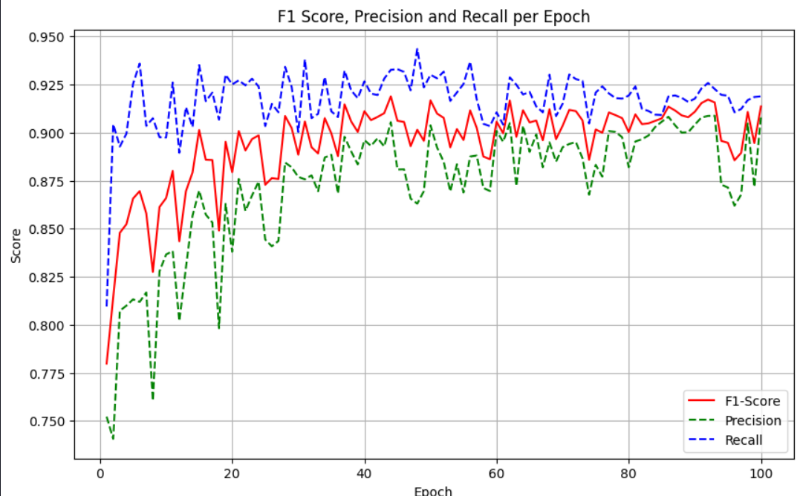
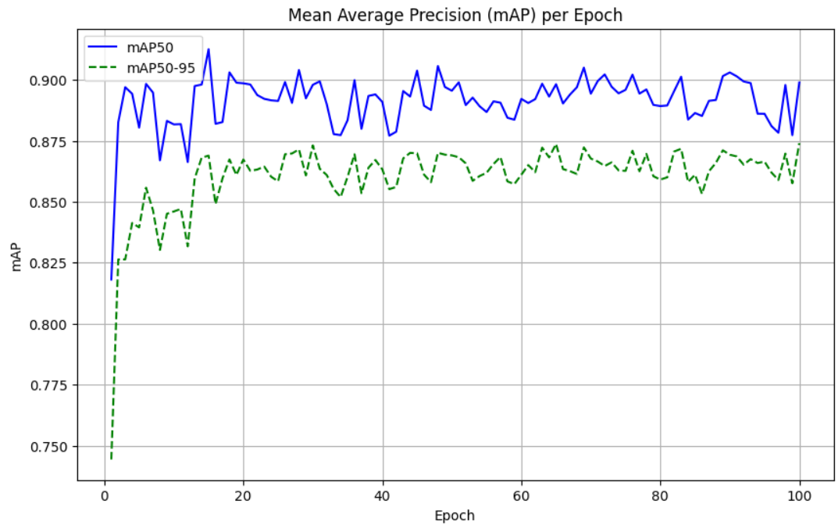
YOLOv8
Notes:
yolov8

Slide 23
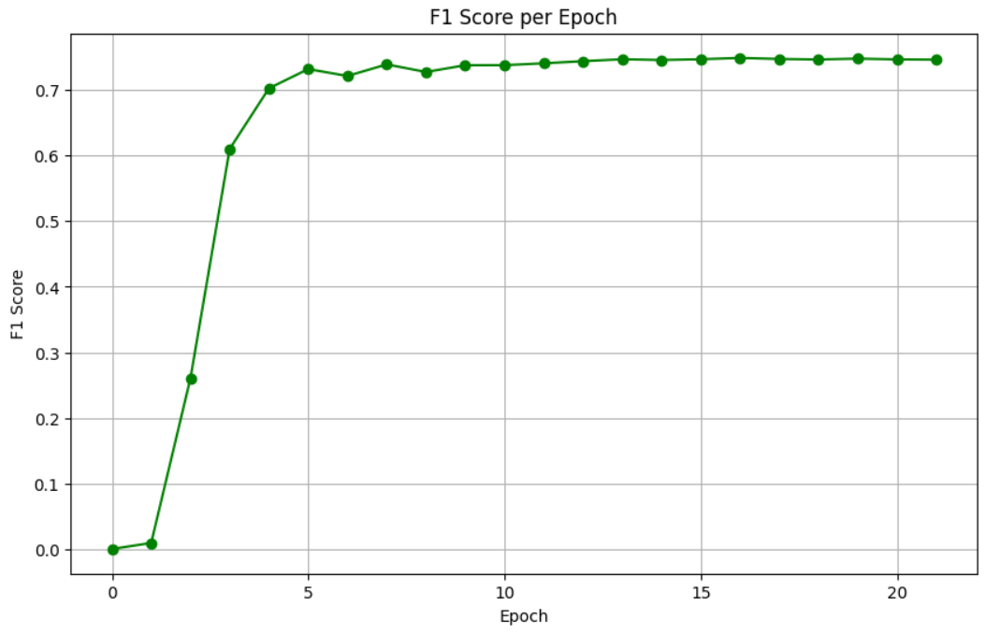
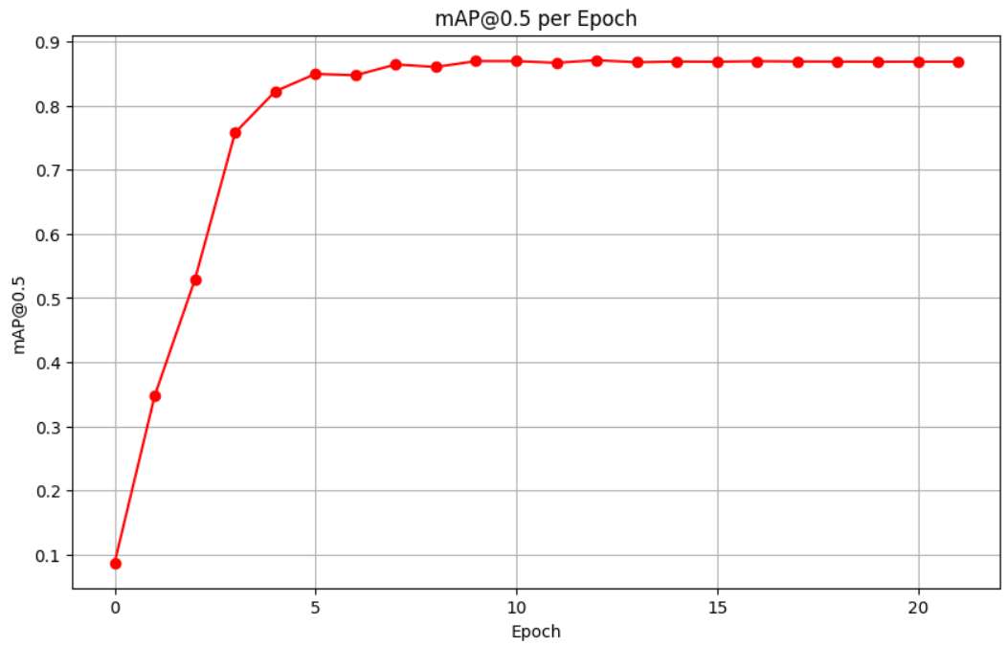
SSD 300

Slide 24
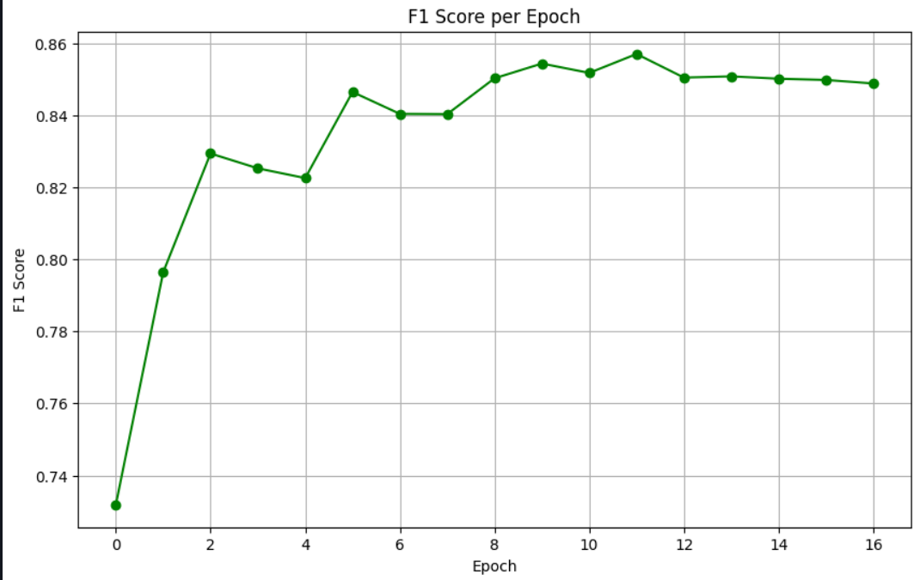
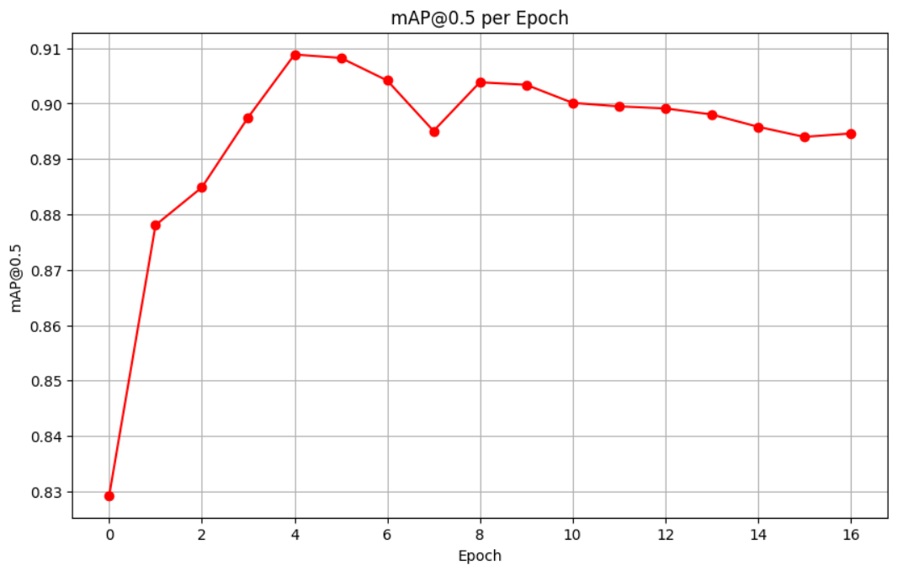
Faster R-CNN VGG16
Notes:
These validation results are added as an evidence of training. These models are trained and tested fairly and no biases. After the training, the model from the best performed epochs from each model training are selected and then tested.

Slide 25
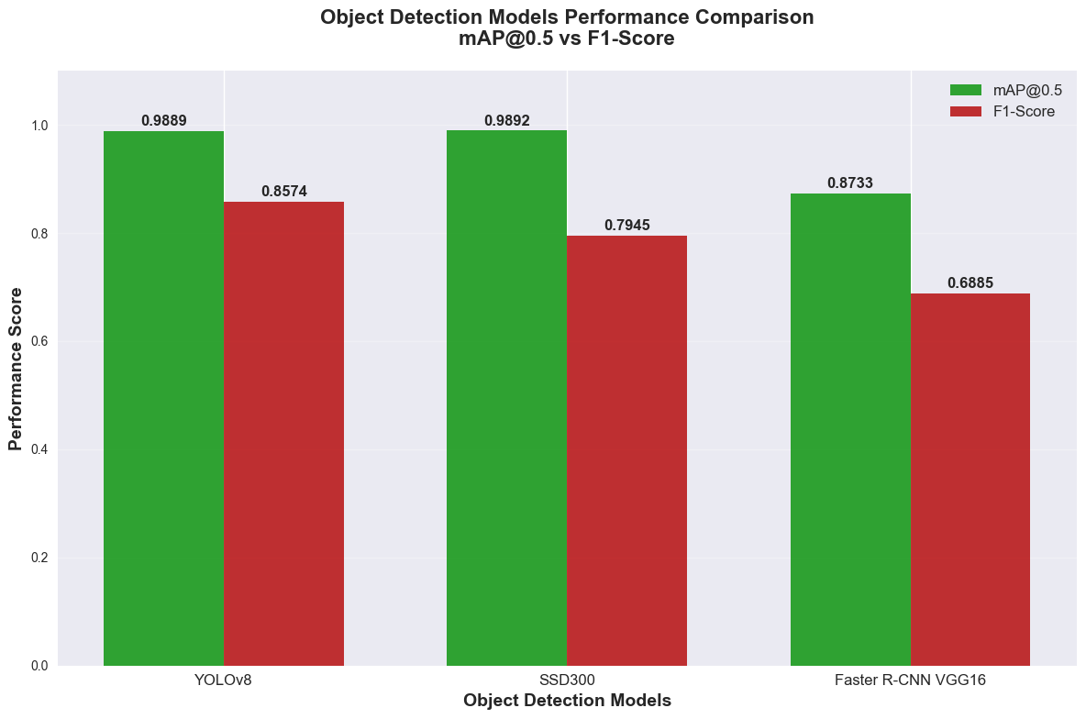
Notes:
Here is the final model comparison results.
The results showed that YOLOv8 achieved the best overall balance between accuracy and reliability, with a mAP of 98.89% and the highest F1-score of 85.74%.
SSD300 slightly outperformed in mAP at 98.92%, but its F1-score was lower, indicating weaker balance between precision and recall.
Faster R-CNN recorded the lowest metrics in both measures.

Slide 26
Main Findings
Notes:
Now move on to the main finding of the study

Slide 27
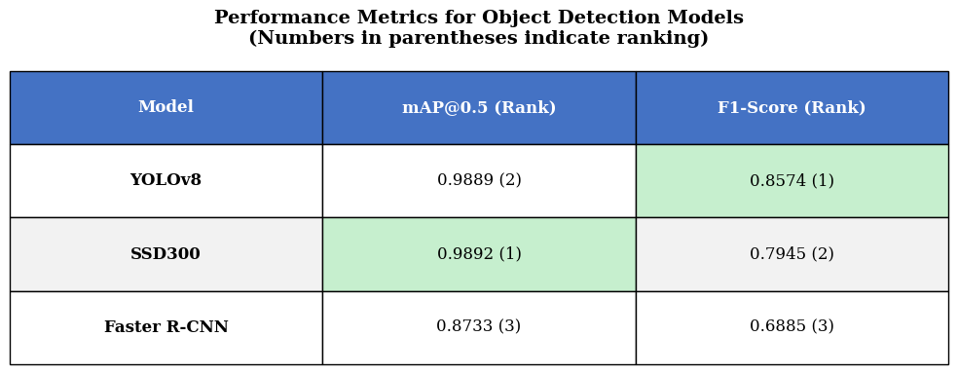
Notes:
This is a summarized performance metrics table to understand the results from the plot. Here we can see that the Yolov8 model achieved the highest f1 score, The SSD model achieved a slighly higher mAP score than the yolov8 model, and the Faster R-CNN model achieved lowest performance.

Slide 28
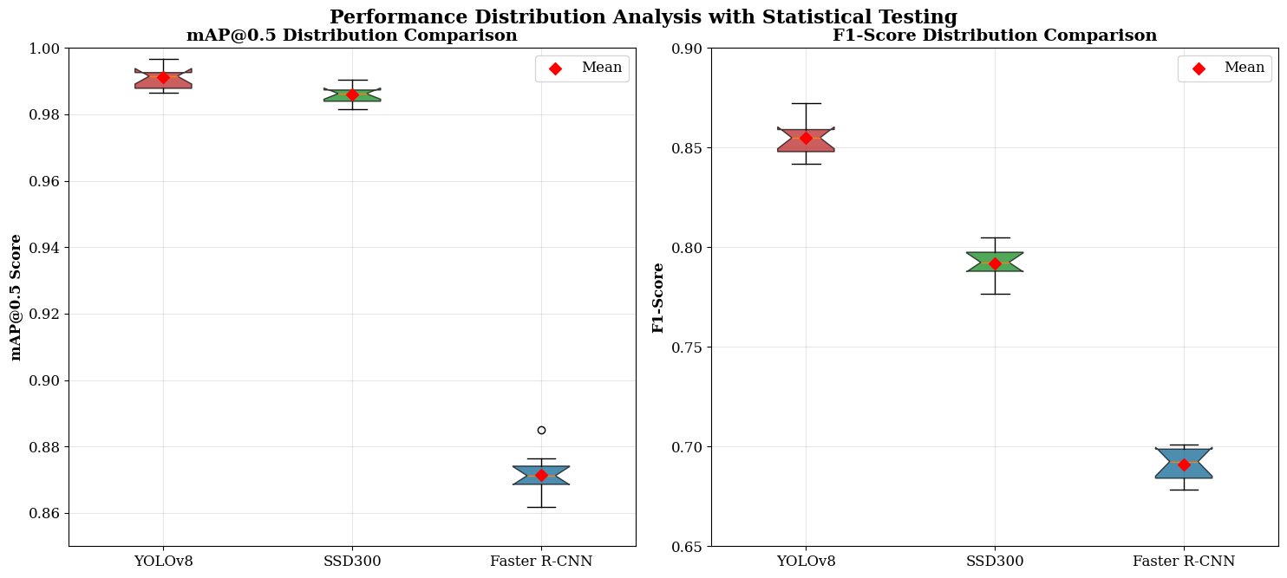
Notes:
Here I made a performance distribution analysis with statistical testing, since the yolov8 and SSD models having some, similarities and up and downs in the performance.
Statistical testing confirmed that the performance difference was significant, supporting the alternative hypothesis which is YOLOv8 will achieve the overall highest performance than the other models.

Slide 29
Demonstration
Notes:
Let me show you a quick demo of the implemented system. This system is built with YOLOv8 which is the best performer of the study.

Slide 30
Limitations
Notes:
As we saw some impressive outcomes, I also would like to address some limitation I had in this research,

Slide 31
Dataset imbalance across 36 classes
No fine-tuning of pre-trained models
Limited testing under varied environmental conditions
Dataset not covering all the signs across the country
Notes:
This study face some key limitations,
first one is, the dataset was imbalanced across classes, and the selected models are not fine tuned, specifically for the dataset.
And the testing was limited to a narrow range of environmental conditions.
And this study only focuses on specific set of traffic signs, and its not covering all the signs available in sri lanka, which is a concern while implementing a system.

Slide 32
Future work
Notes:
The Future Work

Slide 33
Develop balanced and larger dataset
Evaluate performance under varied weather & lighting conditions
Optimize for deployment on edge devices (Jetson, Raspberry Pi)
Fine-tune models for local dataset
Notes:
“For future work, I recommend creating a balanced, larger dataset, covering different signs as much possible.
And, testing models under varied weather and lighting conditions, would improve the reliability of the study and system development.
Another important work would be, optimizing the best-performing model for deployment on low-power edge devices such as Raspberry Pi or Jetson, and fine-tuning the models on the local dataset for further performance gains.”

Slide 34
Conclusion

Slide 35
Conclusion
The research identified YOLOv8 as the best-performing model for Sri Lankan traffic sign detection.
Hypothesis testing confirmed YOLOv8’s superior performance over the other models.
A real-time detection system using YOLOv8 and Streamlit was successfully developed.
The study supports the application of AI in road safety and intelligent transportation systems in Sri Lanka.
Notes:
In conclusion, YOLOv8 was identified as the best-performing model for Sri Lankan traffic sign detection.
Hypothesis testing confirmed YOLOv8’s superiority.
The study contributes a region-specific evaluation and a working real-time detection system.
These results support the development of intelligent transport systems and AI-driven road safety solutions in Sri Lanka.”

Slide 36
Reference

Slide 37
Fatima, Z. T. M. M. H. V. R. R. T. a. R. R., 2024. Performance Comparison of Object Detection Models for Road Sign Detection Under Different Conditions. International Journal of Advanced Computer Science and Applications, 15(12).)
(Jinghao Cao, J. Z. X. J., 2021. A Traffic-Sign Detection Algorithm Based on Improved Sparse R-cnn. IEEE Access.)
(Mishra, A. K. A. M. S. A. K. Z. J. S. S. a. T. A., 2022. Evaluating and Bench-marking Object Detection Models for Traffic Sign and Traffic Light Datasets, s.l.: Computer Vision Foundation.)
Notes:
“Here are the main references I used in this study.”

Slide 38
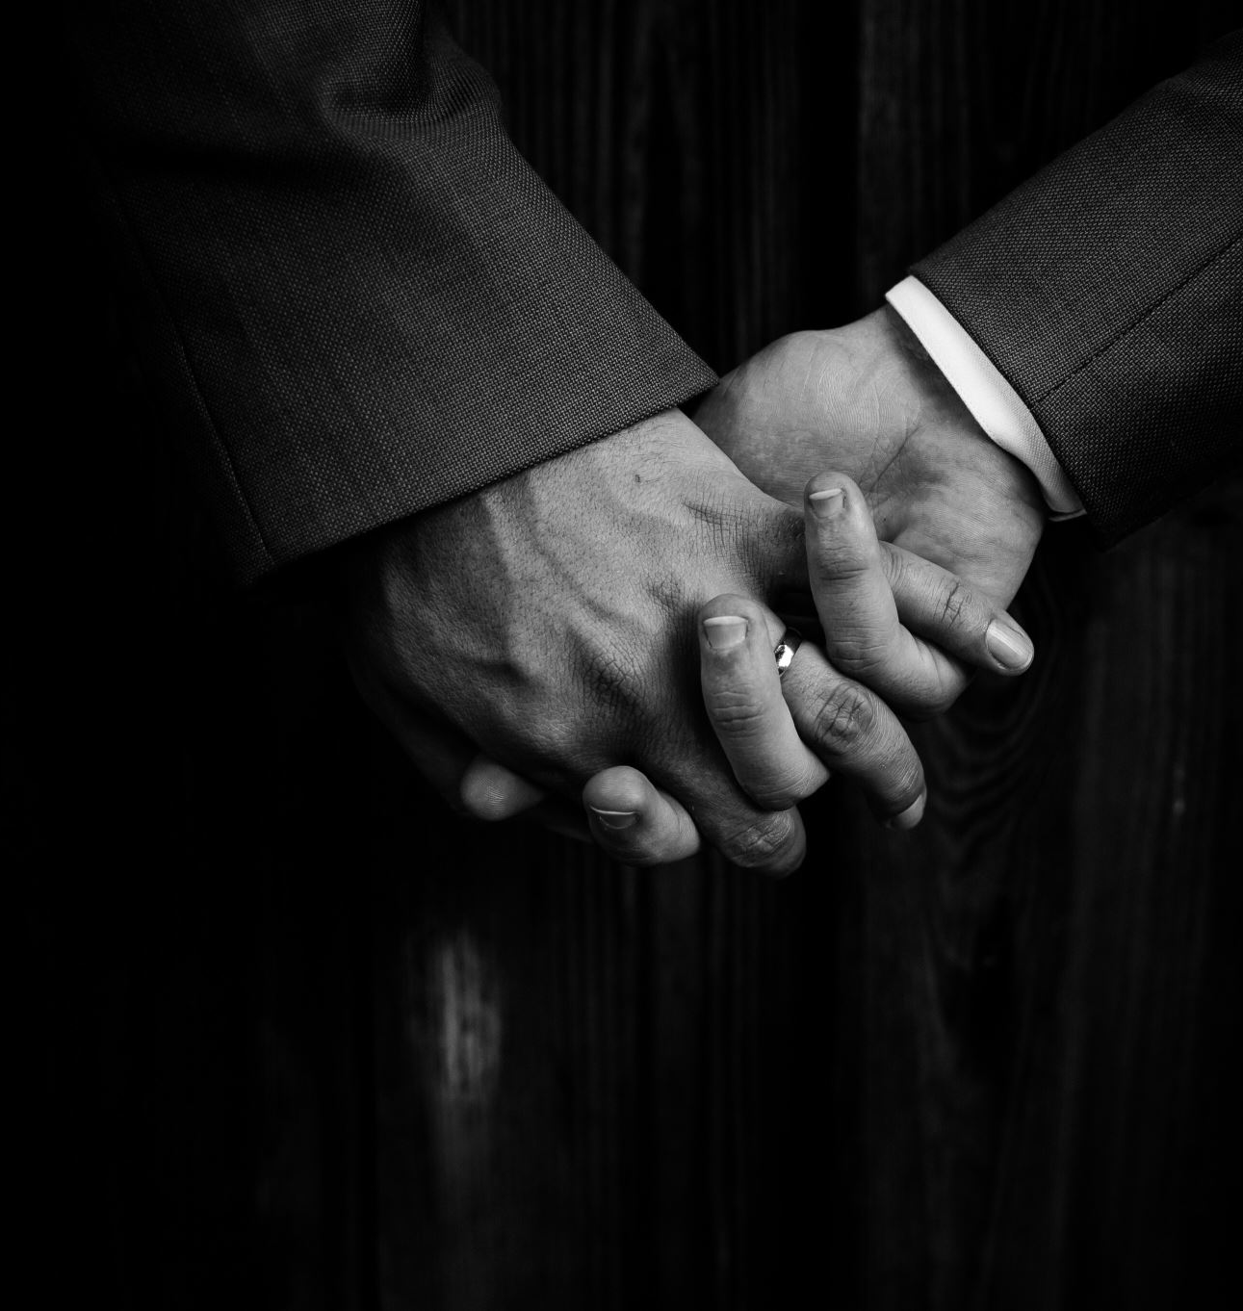
Acknowledgement
Thanks To,
Supervisor: Ms. NF. Mafaza.
Assessor: Ms. ALF. Sajeetha.
BCAS Campus Kalmunai.
Notes:
Before concluding, I would like to express my sincere gratitude to Mrs. NF. Mafaza, my supervisor for their valuable guidance. And the assessor Mrs. ALF. Sajeetha and the coordinator MR. MIM. Nismy, and Engineer Jubailah miss for being here. And the BCAS Campus.
Additionally, I acknowledge the work of previous researchers as well.

Slide 39

Thank you
Notes:
Thank you all for your time and attention!

Slide 40

Questions?
Notes:
If you have any questions, I would be happy to answer. Thankyou.

